Slide 1
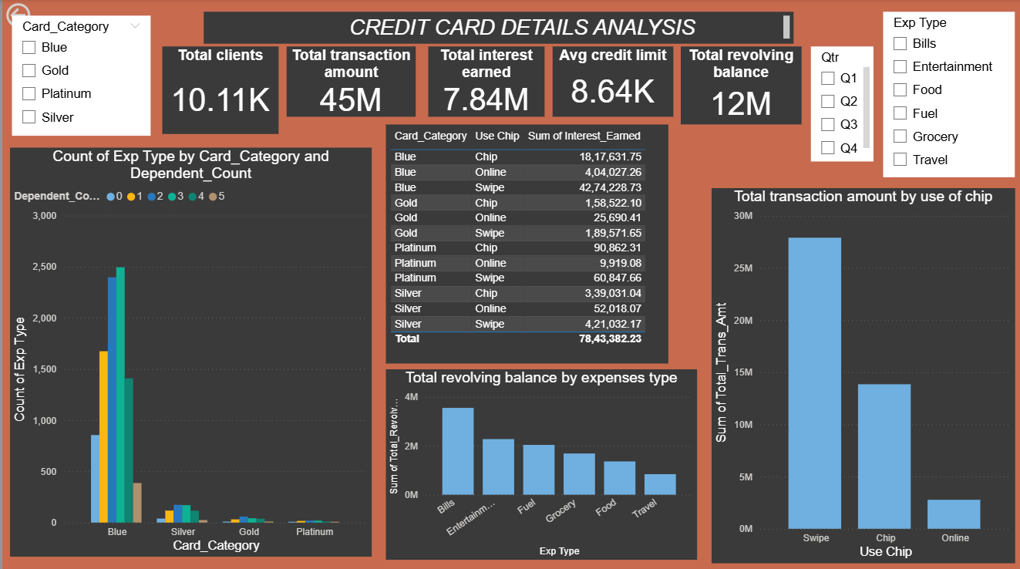

Slide 2
Dashboard Overview
This dashboard provides a comprehensive overview of credit card client behavior, card usage, financial metrics and focuses on
Client base size and their credit card activity
Expense pattern and transaction behaviour
Revenue-generating metrics such as interest and annual fees
Card category analysis for performance insights

Slide 3
Credit Card Usage & Transaction Insights Report
Key Performance Metrics
Metric | Value
Total Clients | 10.11K
Total Transaction Amount | 45M
Total Interest Earned | 7.84M
Average Credit Limit | ₹8.64K
Total Revolving Balance | 12M
1. Transaction Amount by Use of Chip
Use Method | Total Transaction Amount (₹)
Swipe | ₹28M
Chip | ₹17M
Online | ₹4M
Insights:
Physical swiping dominates credit card usage, contributing over 60% of the total transaction volume.
Online payments are the least used, despite their convenience, which could indicate a need to promote online safety or rewards.

Slide 4
2. Interest Earned by Card Category & Use Type
Card Category | Use Type | Interest Earned (₹)
Blue | Swipe | ₹4.27M
 | Chip | ₹1.82M
 | Online | ₹4.04M
Gold | Swipe | ₹1.89L
 | Chip | ₹1.58L
 | Online | ₹25.7K
Platinum | Swipe | ₹60.8K
 | Chip | ₹90.8K
 | Online | ₹9.9K
Silver | Swipe | ₹4.21M
 | Chip | ₹3.39L
 | Online | ₹52K
Insights:
Blue and Silver cards are the top contributors to total interest earned, mainly through swipes and online transactions.
Gold and Platinum cards contribute the least, suggesting these are either less used or benefit from lower interest rates (premium perks).

Slide 5
3. Total Revolving Balance by Expense Type
Expense Type | Revolving Balance (₹)
Bills | ₹4M
Entertainment | ₹2.2M
Fuel | ₹1.8M
Grocery | ₹1.6M
Food | ₹1.4M
Travel | ₹1M
Insights:
Bill payments have the highest revolving balances, suggesting customers defer these payments or carry balances longer.
Travel and food have the lowest, likely due to smaller or infrequent transactions.
4. Count of Expense Types by Card Category & Dependent Count
Card Category | Dominant Dependent Counts | Usage Trend
Blue | 2, 3, 1 | Highest expense count overall
Silver | 1, 2 | Moderate usage
Gold | 1 | Limited usage
Platinum | 1 | Very limited usage
Insights:
Blue cards are the most widely used, especially among customers with 1 to 3 dependents.
Platinum and Gold cards have minimal activity, suggesting premium users are fewer or use other products.

Slide 6
Distribution Summary Across Card Categories
Category | Insights Summary
Blue | Mass-market card, highest transactions and interest earned
Silver | Second most used; strong interest earnings from swiping
Gold | Low transaction and interest activity
Platinum | Minimal contribution overall
Suggestions
Area | Recommendation
Card Promotions | Target Blue and Silver cardholders with cashback offers or tier upgrades.
Online Usage | Encourage online transactions via rewards (as it's the least used method).
Premium Segments | Enhance offerings or marketing for Gold & Platinum cards to boost usage.
Revolving Balances | Consider targeted EMI or low-interest schemes for bill and entertainment spenders.
Dependency-Based Targeting | Customers with 2-3 dependents are high spenders—target for upselling and cross-selling.

Slide 7
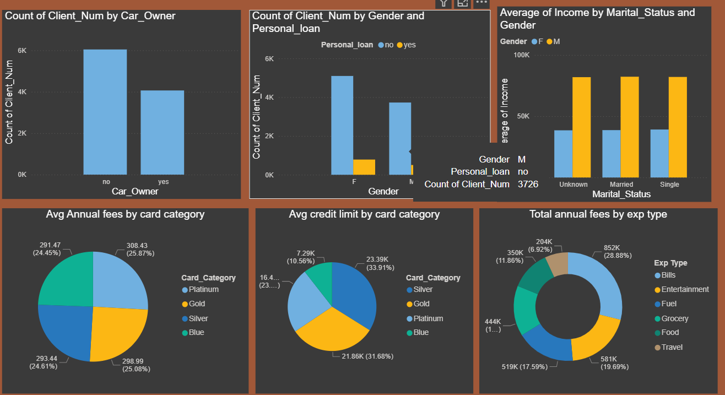

Slide 8
Comprehensive Analysis Report
1. Car Ownership and Client Distribution
Chart: Count of Client_Num by Car_Owner
Insights:
~6,000 clients do not own cars, compared to ~4,000 who do own cars.
Indicates a larger customer base without vehicle ownership, suggesting that transport-related benefits (e.g., fuel rewards) may be less relevant to the majority.
2. Gender vs. Personal Loan
Chart: Count of Client_Num by Gender and Personal_loan
Insights:
Women outnumber men in terms of total clients.
Both genders show that most clients do not hold personal loans.
A slightly higher proportion of males have personal loans than females.
Personal loan marketing may be more effective when targeted toward males.
3. Income by Marital Status and Gender
Chart: Average of Income by Marital_Status and Gender
Insights:
Males earn significantly more than females across all marital statuses.
Married, single, and unknown marital status males earn around ₹90K+, whereas females earn ~₹40K.
Indicates a possible gender income gap, which might impact credit risk and product recommendations.
Married individuals (especially males) may be better candidates for premium credit products.

Slide 9
4. Average Annual Fees by Card Category
Chart: Avg Annual Fees by Card Category
Insights:
All card types have similar average annual fees ranging from ₹291 to ₹308.
Silver card has the highest average annual fee (₹308), followed closely by Gold.
The narrow spread in fees suggests a standardized fee structure, not heavily tiered by benefits.
5. Average Credit Limit by Card Category
Chart: Avg Credit Limit by Card Category
Card Category | Avg Credit Limit (₹) | % Share
Gold | ₹23.39K | 33.91%
Blue | ₹21.86K | 31.68%
Platinum | ₹16.4K | 23.00%
Silver | ₹7.29K | 10.56%
Insights:
Gold and Blue cardholders have the highest average credit limits, suggesting they are targeted toward high-income or trusted clients.
Surprisingly, Platinum cards have a lower limit than Blue, which is counterintuitive and may suggest misalignment in card positioning.
Silver cards have the lowest credit limit, matching their possibly entry-level status.

Slide 10
6. Annual Fees Distribution by Expense Type
Chart: Total Annual Fees by Exp Type
Expense Type | Annual Fees (₹)
Bills | ₹852K (28.88%)
Food | ₹581K (19.69%)
Grocery | ₹519K (17.59%)
Fuel | ₹444K (15.05%)
Entertainment | ₹350K (11.86%)
Travel | ₹204K (6.92%)
Insights:
Bills are the leading contributor to annual fees, indicating frequent usage of cards for utilities or EMIs.
Travel accounts for the lowest fees, meaning either low frequency or limited international use.
There’s potential to promote travel-related reward cards or benefits to boost engagement.

Slide 11
Strategic Suggestions
Area | Actionable Recommendation
Card Limit Adjustments | Reevaluate Platinum card positioning if its limit is below Blue.
Loan Marketing | Target males with personal loan offers, as they have higher uptake.
Gender Equity | Consider custom offerings for women, given the income gap and lower loan adoption.
Product Re-alignment | Fuel and Travel rewards may be downplayed for non-car owners.
High-Use Segments | Bills, food, and grocery spenders are strong fee generators—offer more cashback here.
Premium Promotions | Focus Gold and Blue cardholders for limit upgrades, perks, or EMI offers.

Slide 12
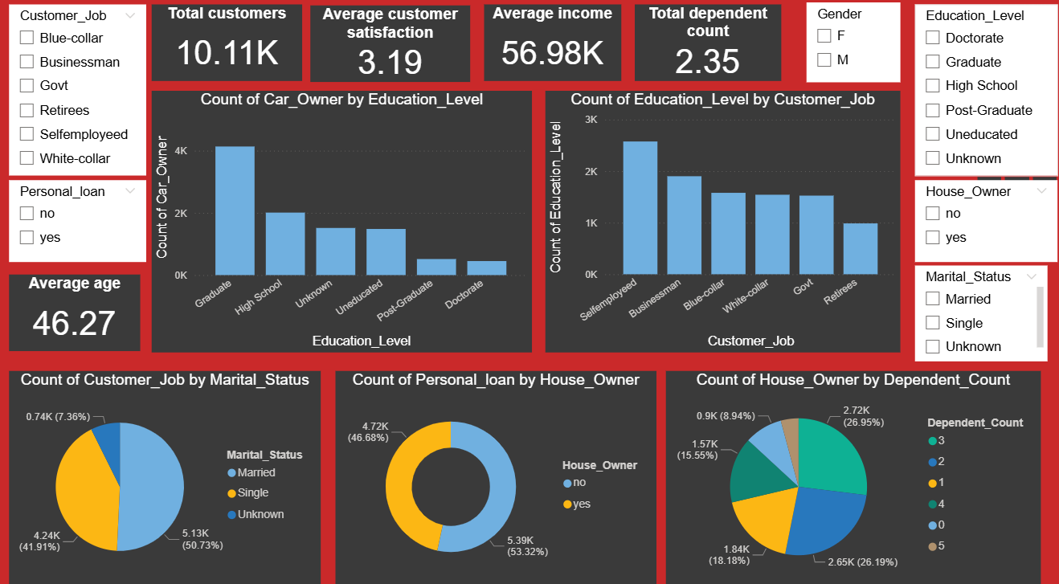

Slide 13
Customer Insights Report from Dashboard
Overview KPIs:
Total Customers: 10.11K
Average Age: 46.27 years
Average Customer Satisfaction: 3.19 (scale not defined)
Average Income: $56.98K
Average Dependent Count: 2.35
Key Insights:
1. Car Ownership by Education Level
Most car owners are Graduates (over 4K customers).
High School and Unknown education levels follow.
Very few car owners have Doctorate or Post-Graduate degrees.
2. Education Level by Job Type
Self-employed individuals are the most frequent across education levels, especially Graduate and High School.
Businessmen, Blue-collar, and White-collar jobs also show a strong presence across common education levels.
3. Customer Job by Marital Status
Married customers represent the largest portion (50.73%).
Single customers are the second-largest group (41.91%).
Unknown marital status makes up a small minority (7.36%).
4. Personal Loan by House Ownership
Slightly more personal loan customers are not house owners (53.32%) compared to those who are (46.68%).
This may suggest that customers without assets (homes) are more likely to seek loans.

Slide 14
5. House Ownership by Number of Dependents
House ownership is most common among customers with:
2 Dependents (26.95%)
1 Dependent (26.19%)
3 Dependents (18.18%)
House ownership decreases significantly as the number of dependents rises beyond 3.
Conclusion:
The data points to a customer base that is:
Predominantly middle-aged
Mostly married
Moderately educated (Graduates, High School)
More likely to own a car if they have a graduate education
Seeking personal loans more often when not owning a house
House ownership is closely tied to having 1–3 dependents
Key Business Insights
Focus on graduate-level individuals for premium offers (cars, property).
Target single or non-house owning individuals for loan products.
High potential in the self-employed demographic for financial services.

Slide 15
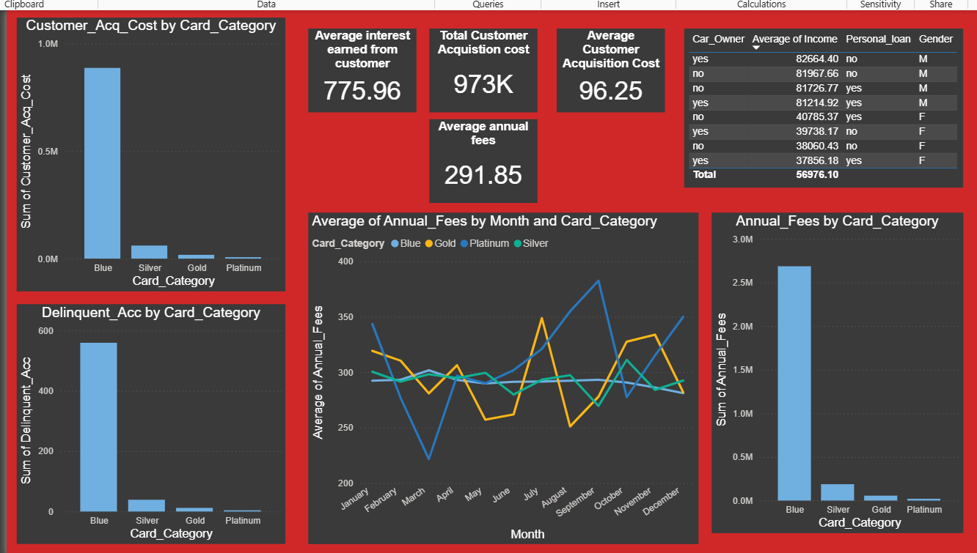

Slide 16
Customer Acquisition Cost by Card Category
Blue Card customers have the highest total acquisition cost, exceeding 1 million, dominating all other categories.
Other categories have significantly lower costs:
Silver: relatively low
Gold and Platinum: negligible in comparison
Insight: The bank invests heavily in acquiring Blue card customers, which may require ROI evaluation.
Delinquent Accounts by Card Category
Blue Card has the highest number of delinquent accounts, around 550–600.
Silver, Gold, and Platinum cards have far fewer delinquents.
Insight: Blue card customers are not only the most costly to acquire but also represent the highest credit risk.
Annual Fees by Card Category
Blue Card generates the highest total annual fees—about 2.7M, indicating a large user base.
Silver, Gold, and Platinum generate significantly lower revenues:
Silver: 200K
Gold and Platinum: <100K
Insight: Blue cards dominate in both costs and revenues, but profitability needs to be compared with risks (delinquency).
Average Annual Fees by Month and Card Category
All card categories show fluctuating patterns across months.
Blue and Gold cards show more volatility than Silver and Platinum.
Spikes in average annual fees are visible in August and December for some categories.
Insight: Certain months might involve promotional offers or customer upgrades increasing the fees.

Slide 17
Customer Demographics Table
Breakdown by:
Car Owner Status
Average Income
Personal Loan Status
Gender
Total average income across all rows is 56,976.10
Car owners tend to have slightly higher average incomes.
There's a mix of personal loan statuses and gender representation.
Insight: Car ownership and income are likely influencing product eligibility or card type.
Combined Insights
Blue Card Customers:
High acquisition cost
High delinquency rate
Highest annual fees (likely due to high customer count)
Could be less profitable due to delinquency risk
Silver, Gold, and Platinum Cards:
Low acquisition and delinquency costs
Lower revenue generation
Might serve niche or premium market with lower default risk
Potential Strategy Suggestions:
Reassess acquisition strategies for Blue cards to reduce cost and risk.
Increase marketing or benefits for Silver/Gold/Platinum to diversify the portfolio.
Investigate patterns behind monthly fee spikes for optimization.

